Slide 1

Password Management App
2023
Group members: 陈彦竹 储子杰 何达斌

Slide 2
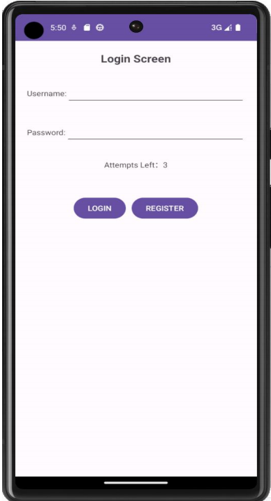
Login interface
The welcome screen displays App name and login/registration button.If a match is found, the login success page is displayed.

Slide 3
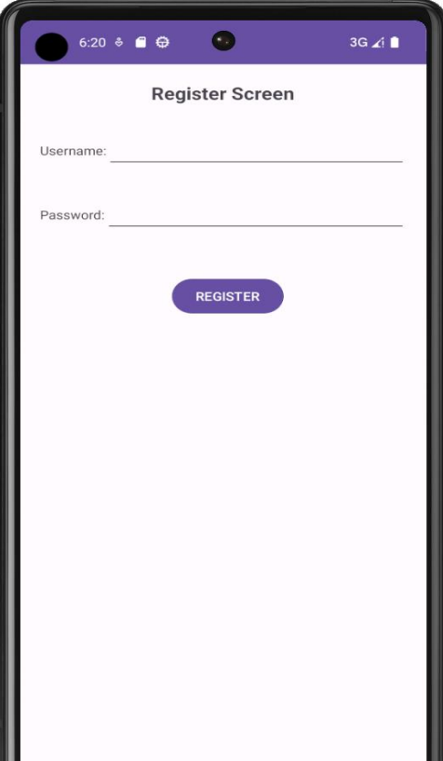
Registration interface
The user name and password are entered in two separate fields, and buttons are placed at the bottom of the screen. The user name and password entered are passed back to the login page when the sign Up button is clicked.

Slide 4
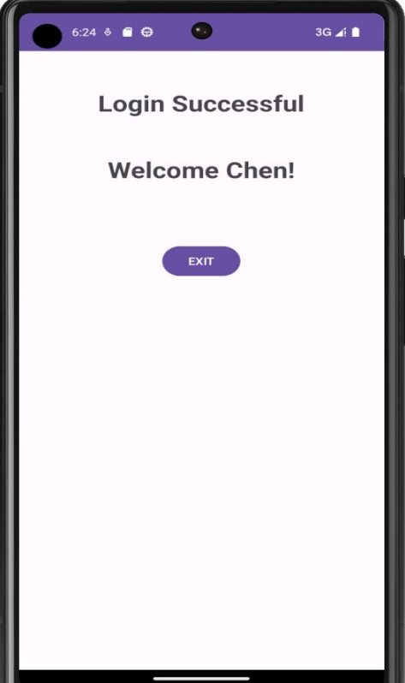
Successful interface
The login success page receives the userName sent during login and displays it.

Slide 5
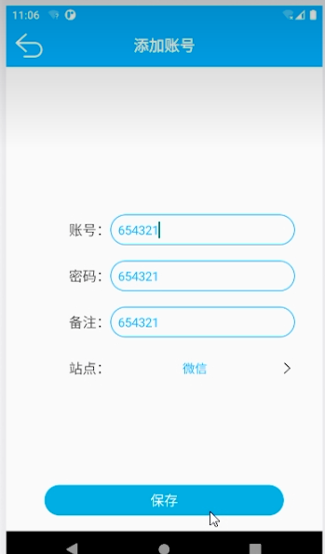
Add password interface
Enter the application name, account, password and remarks in the three input boxes respectively. Save button is placed at the bottom of the screen.

Slide 6
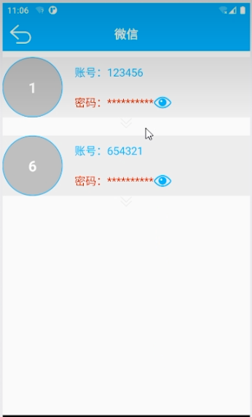
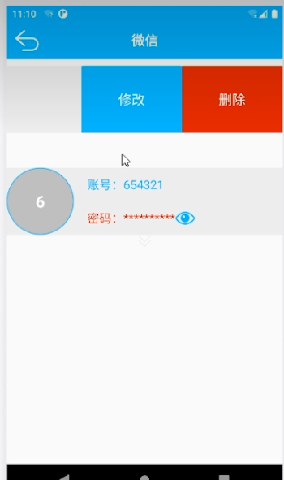
Password details interface
The app name, account, and password are displayed as labels and text boxes, respectively, and the edit and delete buttons are also displayed as side pulls.

Slide 7
Thank you for listening
2023
Group mumbers: 陈彦竹 储子杰 何达斌

